Slide 1
Mathematics and Music a harmonious connection
Dr. Keith E. Mellinger
Professor of Mathematics
and Director of the Quality Enhancement Plan
joint work with
Bud Brown and Alissa Crans

Slide 2
The musical clock

Slide 3
What is a triad?
By a triad, or chord, we mean three pitches played simultaneously
For instance,
a C-Major triad consists of the pitches C, E and G.
an a-minor triad consists of the pitches A, C, and E.
We represent triads as vectors over Z₁₂
C-Major = < 0, 4, 7 >
a-minor = < 4, 0, 9 >

Slide 4
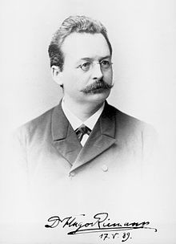
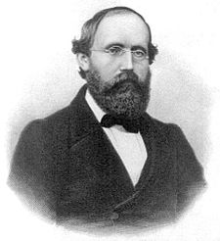
Hugo Riemann
Karl Wilhelm Julius Hugo Riemann (July 18, 1849 – July 10, 1919) was a German music theorist and composer.
Bernhard Riemann
(the “Riemann Sum” guy)

Slide 5
Operations on triads
The 19th century music theorist Hugo Riemann defined these operations
P – parallel,
L – leading tone exchange, and
R – relative
Examples:
P(C-Major) = c-minor
L(C-Major) = e-minor
R(C-Major) = a-minor

Slide 6
Mathematical descriptions of chord progressions
C-Major → a-minor → F-Major → G-Major
C → R(C) → L(R(C)) → T₂(L(R(C)))
Stand by Me
Every Breath you Take
Those Magic Changes
Eternal Flame

Slide 7
Majors and minors
C G Am F
C G F C
When I find myself in times of trouble, mother Mary comes to me
Speaking words of wisdom, let it be

Slide 8
The operator P parallel minor
Original triad
C – major
< 0, 4, 7 >
Image under P
C – minor
< 0, 3, 7 >

Slide 9
The operator L leading tone exchange
Original triad
C – major
< 0, 4, 7 >
Image under P
E – minor
< 11, 4, 7 >

Slide 10
The operator R relative minor
Original triad
C – major
< 0, 4, 7 >
Image under P
A – minor
< 0, 4, 9 >

Slide 11
Matrix Representations
Linear operation
Matrix representation
Under the operation P
< x, y, z > →
< z, x – y + z, x >
[x, y, z] $\left[\begin{matrix}0 & 1 & 1 \\ 0 & −1 & 0 \\ 1 & 1 & 0\end{matrix}\right]=$
[z, x-y+z, x]

Slide 12
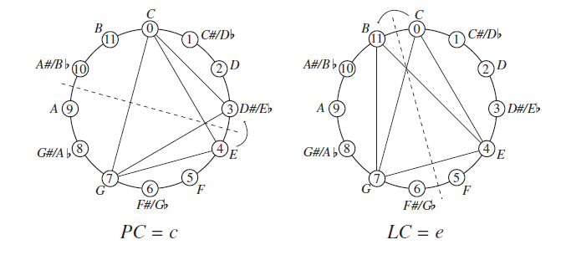
Dihedral actions?

Slide 13
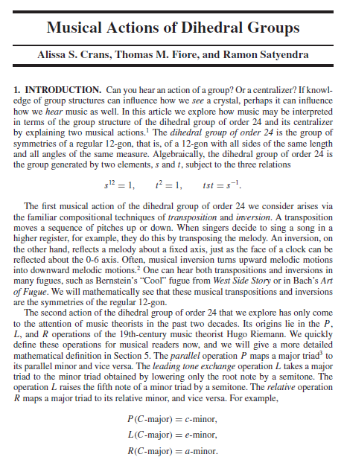
Musical actions of dihedral groups
Winner of the Hasse Award
Year of Award: 2011
The American Mathematical Monthly, vol. 116, no. 6, June 2009, pp. 479-495.

Slide 14
What is an eigenvector?
Matrices move vectors
Some matrices do this…
$$\left[3,1\right]×\left[\begin{matrix}1 & 2 \\ −1 & 0\end{matrix}\right]=[2,6]$$
$$\left[1,2\right]×\left[\begin{matrix}1 & 2 \\ 1 & 2\end{matrix}\right]=\left[3,6\right]=3×[1,2]$$

Slide 15
The study of matrices and vectors lies in an area we call Linear Algebra. Just as chords can be modeled with vectors, so too can many other things.
This allows us to use mathematics to study these objects.

Slide 16
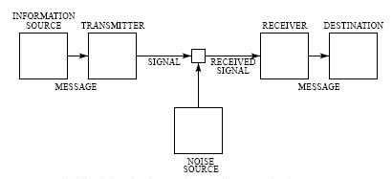
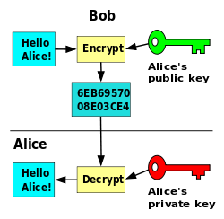
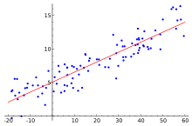
Linear Algebra is used all over the place!
Cryptography
Error-correcting codes
Linear modeling

Slide 17
Are eigenvectors useful?

Slide 18
Eigenvectors…ur…eigentriads?
We can consider musical triads that act as eigenvectors under one of these operators.
We want to know what sort of triad can satisfy:
P(v) = kv
where k is a “scalar”
you just make it longer
when you try to move it

Slide 19
Triads in terms of ‘thirds’
Major and minor thirds
Major and minor triads
A major third is 4 half steps
A minor third is 3 half steps
A Major triad is a major third followed by a minor third
A minor triad is a minor third followed by a major third

Slide 20
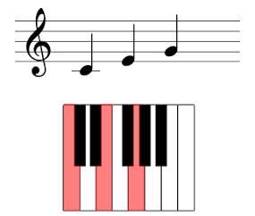
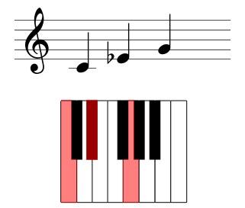
on the piano
a major triad
a minor triad

Slide 21
Eigentriads
Major and minor triads never show up as eigentriads
Eigentriads need to have more “evenly spaced” notes
So, what kind of triad consists of a pair of either major thirds or minor thirds?

Slide 22
Diminished and Augmented chords
A diminished chord is a pair of stacked minor thirds
An augmented chord is a pair of stacked major thirds

Slide 23
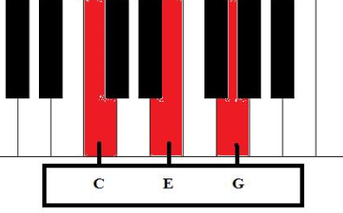
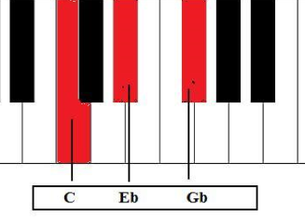
Diminished chords
Major – 4 + 3
Diminished – 3 + 3

Slide 24
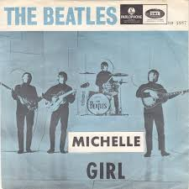
Michelle (The Beatles)
D Gm
Michelle, ma belle
C Ddim A
these are words that go together well,
D A
my Michelle

Slide 25
All Star (Smash Mouth)
Simple version:
E A B A
Hey now, you're an all-star, get your game on, go play
With diminished:
E A A#dim A
Hey now, you're an all-star, get your game on, go play

Slide 26
As a transition chord
Diminished chords also act as a nice transition between a whole step
Rather than D – Em, use D – D#dim – Em
Example in Jingle Bell Rock:
D D#dim Em
jingle around the clock...

Slide 27
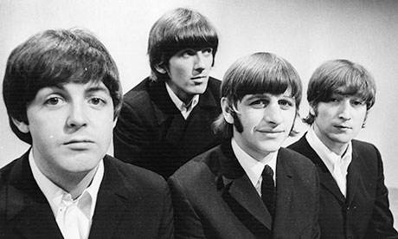
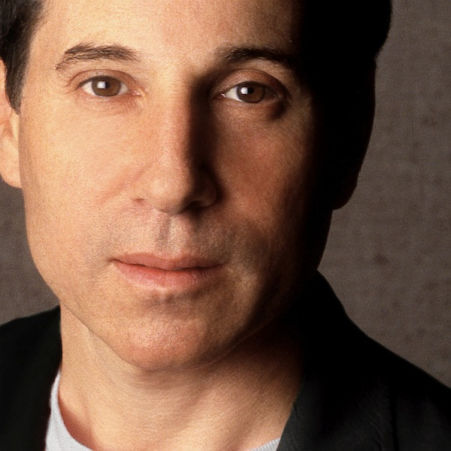
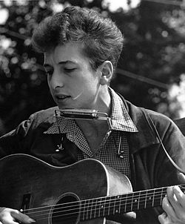

Slide 28
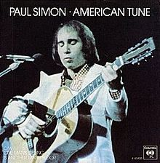
American Tune (Paul Simon)
C
And I dreamed I was dying
G Am Ddim
And I dreamed that my soul rose unexpectedly
G
And looking back down at me
F C G
Smiled reassuringly

Slide 29
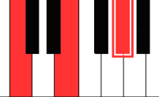
Augmented chords
Major – 4 + 3
Augmented – 4 + 4

Slide 30
From Me to You (The Beatles)
Gm C7
I got arms that long to hold you
F
and keep you by my side.
D7
I got lips that long to kiss you
G G+
And keep you satisfied

Slide 31
Baby Hold On To Me (Eddie Money)
D D+
Baby hold on___ to me__
Whatever will be__ will be__
The future is ours___ to see__
So baby hold on___ to me__

Slide 32
Goodnight Saigon (Billy Joel)
Am Em C Dm E Dm E
We held the day in the palm of our hand.
Am Em C Dm E Dm C+
They ruled the night and the night seemed to last

Slide 33
Why these triads?
It does make some sense. The augmented and diminished triads consist of notes that are “evenly spaced.”
When you scalar multiply them, that spacing is “maintained.”
From the matrix definition, when you operate on them, two coordinates are retained, and so the image will retain some of that structure as well.

Slide 34
Possible musical meaning
A possible musical reason for the augmented and diminished chords being eigentriads is that they do not change form, and therefore cannot stand alone melodically.
The Major and minor triads can and do change parity under these three fundamental transformations: they can move and change into something else. But the augmented and diminished triads are stuck.

Slide 35
Other Eigentriads?
P, L and R have many eigentriads, other than those we have already mentioned. However, most have no meaning musically (at least in Western music).
For example, <7, 5, 6> is an eigenvector under R (with eigenvalue 11).
These collections of pitches could very well play a role in the music of other cultures.

Slide 36
Thank you
Thanks the Fennemores for their kind invitation to speak to you today.
Thanks to my collaborators, Bud Brown and Alissa Crans
Thanks for your attention

